Slide 1
The prediction of suicide in Facebook data using machine learning algorithms
Chun Hin Chan
24727164

Slide 2

Background
According to the statistics from Lifeline, the overall suicide rate in Australia in 2015 is the highest suicide rate in 10-plus years.
12.6 people per 100,000
People’s emotions are the most important signal for us to concern about the suicide problem
How to understand/ notify the change of people’s emotions
By social communication media
Why choose Facebook?
Facebook and Twitter both are famous social communication media
Similar research already did on Twitter
research on Twitter about suicide prediction researched by Birjali, Beni-Hssane and Erritali in 2016

Slide 3
Key challenges
Machine learning Algorithms
Extracting data from Facebook with a clear format

Slide 4
Project Problem and Solution
Problem: Check out which machine learning algorithms are better to classify the message posts in Facebook
Solution:
Extract Facebook posts data
Use different classifiers
Get their accuracies and compare them
Target Classifier: Decision Tree and Naïve Bayes
Tools to extract Facebook posts data: Facepager
Tools for the whole project: python

Slide 5

User Interface
Welcome Page
Start the program
End the program

Slide 6
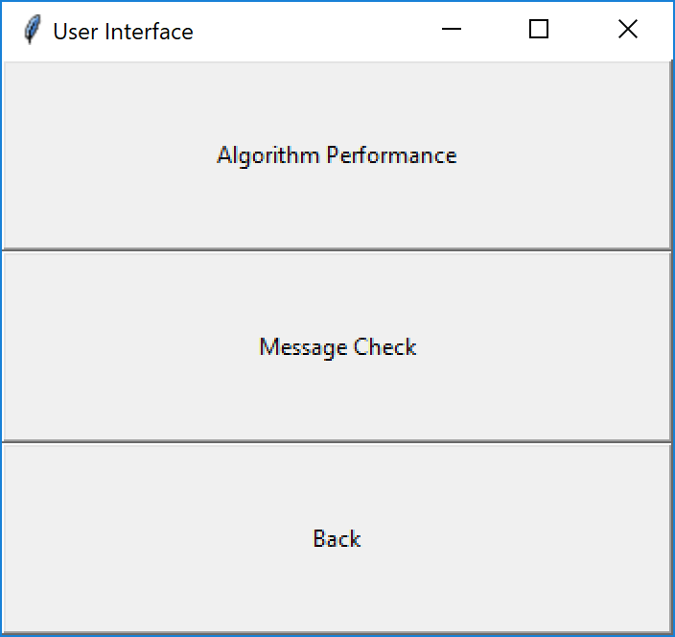
User Interface
Menu page
Option 1: Algorithm Performance
Show the accuracy of the machine learning algorithms
Option 2: Message Check
Check whether the user input message include suicide related keywords with the better classifier in the option one
Option 3: Back
Return to the pervious page

Slide 7
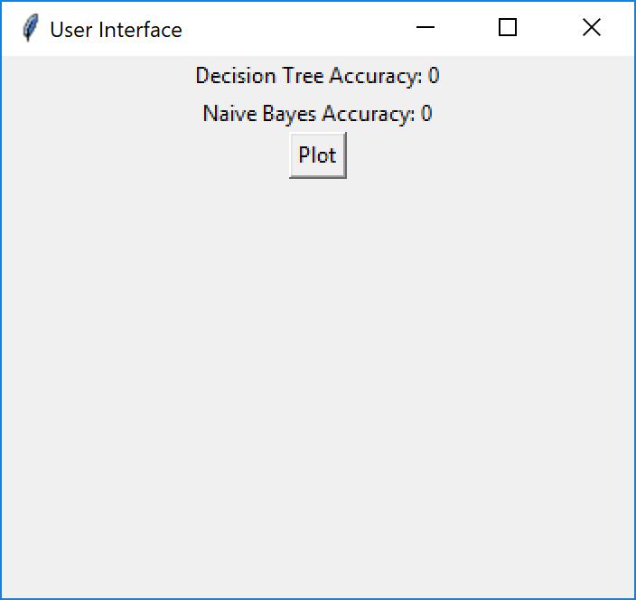
User Interface
Option 1
Show the Accuracy
Plot button: plot a bar chat to show the percentage of the accuracy

Slide 8
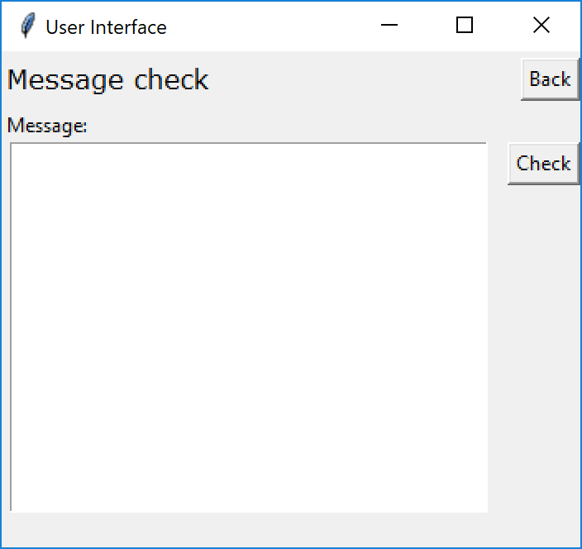
User Interface
Option 2
Back button: return to pervious page
Text Area: input message
Check button: return the result of classification

Slide 9
Demo Time

Slide 10
Limitations and future works
Limitations
Hard to extract enough Facebook posts with suicide related keywords
Not enough data attributes
Decision Tree accuracy is not accurate at all
Future works
Compare more different machine learning algorithms
Improve the current techniques to enhance the accuracy of the current methods

Slide 11
References
Birjali, M., Beni-Hssane, A., and Erritali, M. (2016). Prediction of Suicidal Ideation in Twitter Data using Machine Learning algorithms. International Arab Conference on Information Technology (ACIT'2016).
Monnappa, A. (2015). How Facebook is Using Big Data - The Good, the Bad, and the Ugly. Retrieved from https://www.simplilearn.com/unlocking-data-science-webinar
Sherlock, D.(2014). Extract Facebook Data and save as CSV. Retrieved from https://www.youtube.com/watch?v=S9kYApoR8U4
Loria, S. (2017). Tutorial: Building a Text Classification System. Retrieved from http://textblob.readthedocs.io/en/dev/classifiers.html

Slide 12
Thank you !

